Slide 1


Magazine
Archives
Special pricing for WiLS
Jaye Hess
Regional Sales Manager

Slide 2
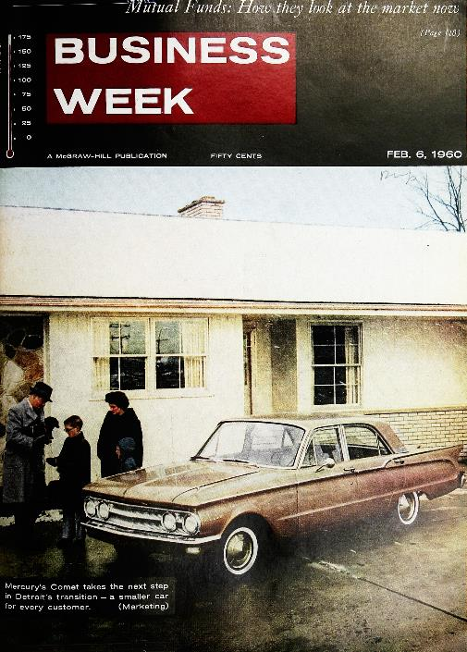
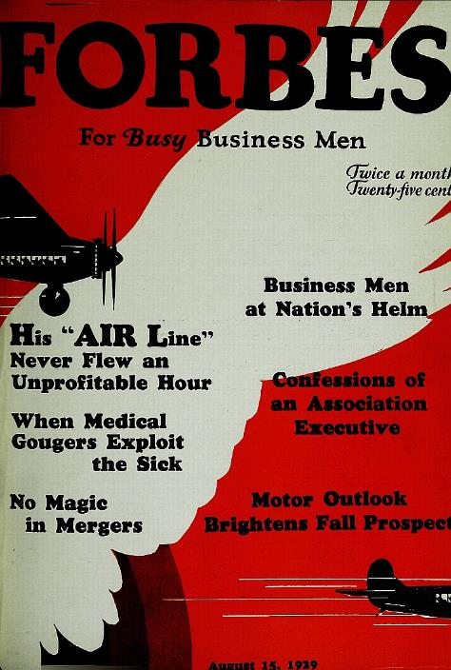
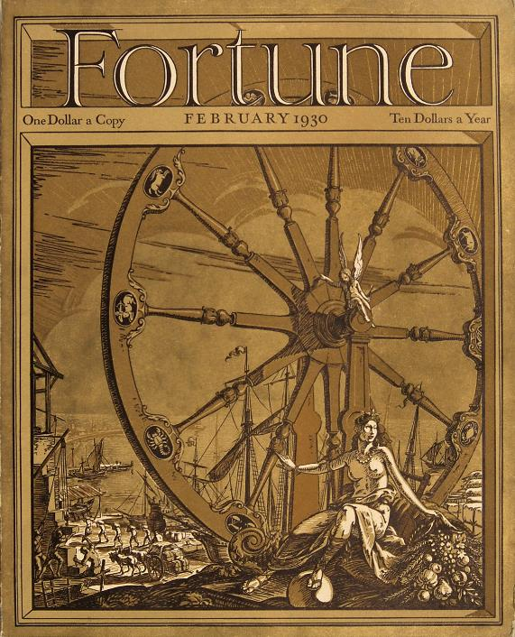
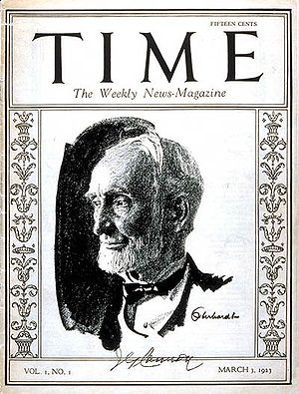
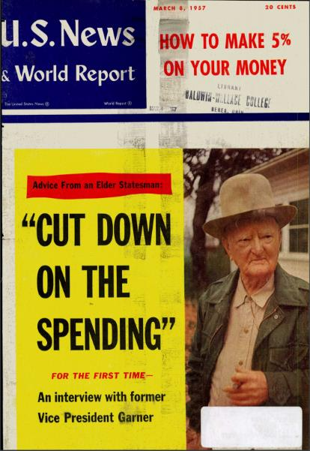


Magazine Archives from EBSCO
1929 - 2000
1917 - 2000
1930 - 2000
1922 - 2000
1926 - 1984
1923 - 2000

Slide 3
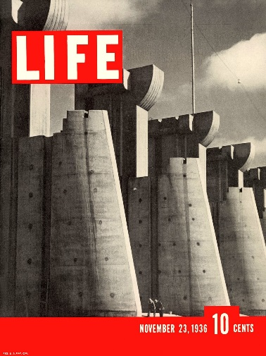
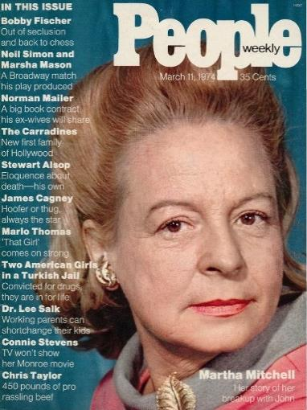
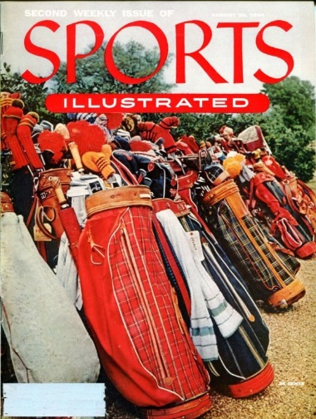
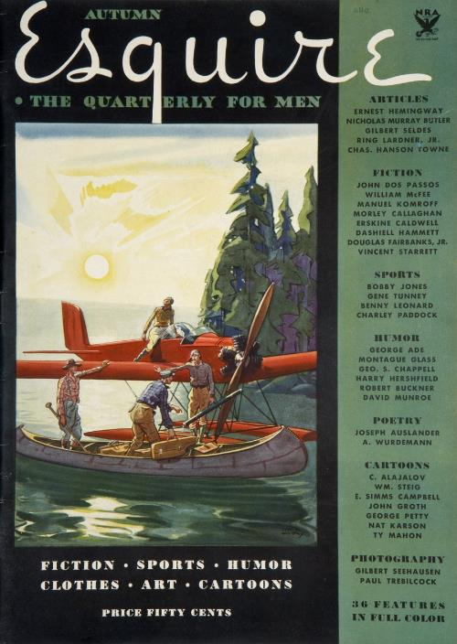
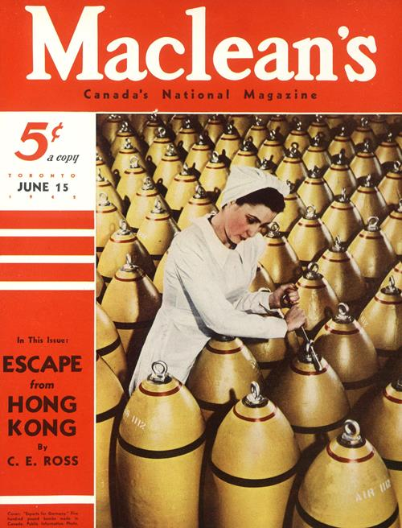
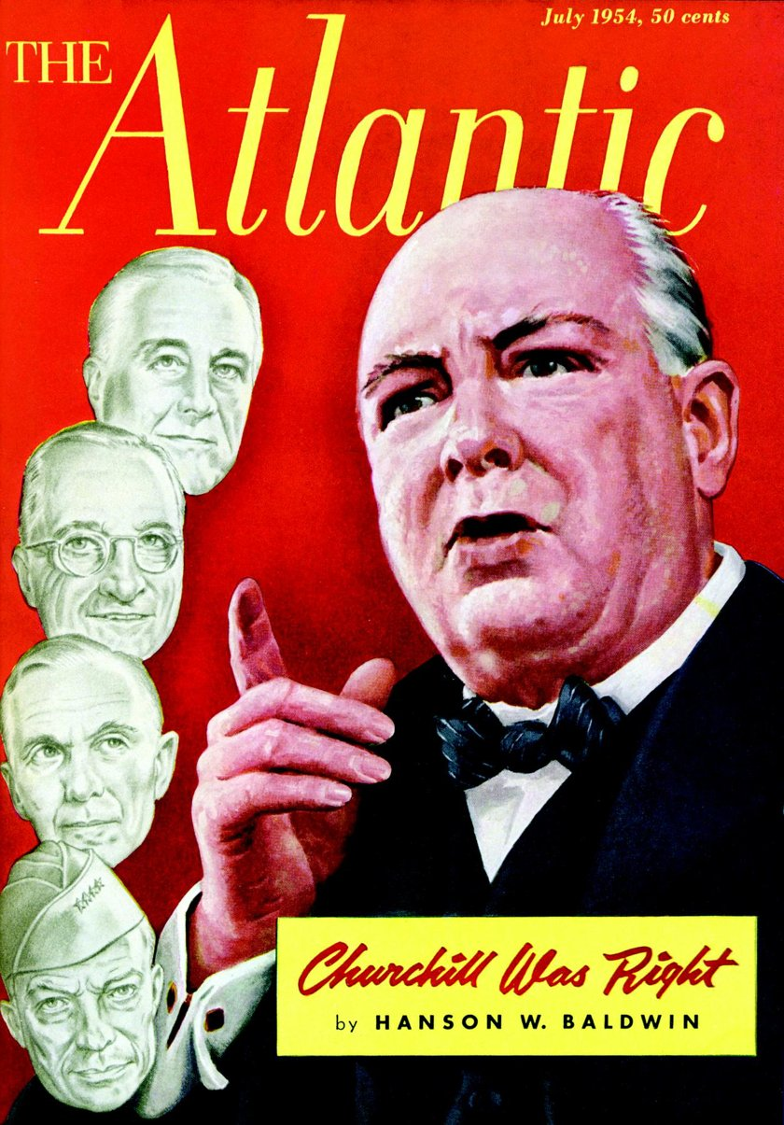
Magazine Archives from EBSCO
1936 - 2000
1974 - 2000
1954 - 2000
1933 - 2014
1905 - 2015
1857 - 2014

Slide 4
Benefits of Adding Magazine Archives to Your Collection
Fill in gaps from missing, lost or damaged issues
Save valuable shelf space
Free up space for study areas, reading nooks and collaborative work spaces
Provide a unique historical perspective for topics throughout the 20th century:
  Explore product advertising and its evolution
  Trace the history of gender issues
  Study how key political events were covered at the time the events occurred
  Investigate trends in the changes of attitude toward race and ethnicity
  Follow the history of business and the changing economic climate
  And much more

Slide 5
Special Pricing for WiLS Customers
Choose the option that fits your researchers’ needs. The more magazine archives you purchase, the greater savings you’ll enjoy.
BUY 1
magazine archive
BUY 2 - 3
magazine archives
BUY 4 - 6
magazine archives
BUY 7+
magazine archives
and receive 35% off your order
and receive 40% off your order
and receive 45% off your order
and receive 50% off your order
Additional savings: If an individual institution has purchased any of EBSCO’s magazine archives in previous years, that will count toward the pricing discount for new purchases this year. For example, if (college A) purchased 4 magazine archives last year, they would enjoy a 45% discount on new titles this year, even for just one new magazine archive.
There will be an annual access fee equal to 2% of the purchase price of the archive.

