Slide 1

S2O, PLUS+ Journals,
2024 Book Collections, and
Latin American Books
Doug Storm
Sales Manager – US & Canada

Slide 2


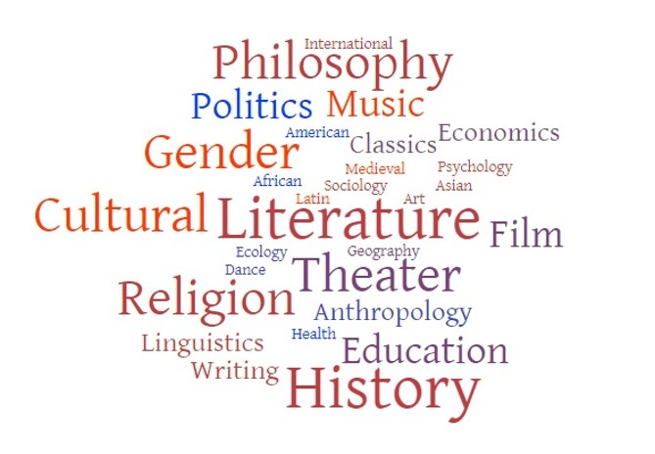

What is Project MUSE?
Not-for-profit publishers
Journals
Books
Libraries
Digital Scholarship
Hopkins Press
Notes:
Before going too far, allow me to provide a brief introduction for Project MUSE. We are an online platform for scholarship in the humanities and social sciences, with content from some 800 scholarly journals, and more than 85,000 academic books, along with other forms of digital scholarship, published by more than 300 distinguished university presses, scholarly societies, and related not-for-profit publishers. The platform offers both great breadth and depth across a wide variety of disciplines, as well as a wealth of cutting edge interdisciplinary scholarship. We were founded nearly 30 years ago as a grant-funded partnership between the libraries and the university press at Johns Hopkins, and still make our home as a division of the Hopkins Press. One of the most important features of MUSE is that all of our content is digital rights management-free, with unlimited use, and no restrictions on simultaneous usage, downloading, or printing. Our platform is responsive and mobile friendly, and ensuring the accessibility of our materials is one of our core values.

Slide 3

Subscribe to Open at Project MUSE
Notes:
While we always have a lot going on at MUSE, one of our most exciting current initiatives is the work we are doing to prepare a Subscribe to Open offer around our flagship journal collections, which have been an essential resource in libraries of all types for nearly 30 years. Beginning with a year of research and business modeling funded by a planning grant from the Mellon Foundation’s Public Knowledge Program, we have been developing a Subscribe to Open – or “S2O” – program across multiple journal titles and participating publishers, that will begin with the 2025 calendar year subscription term.

Slide 4
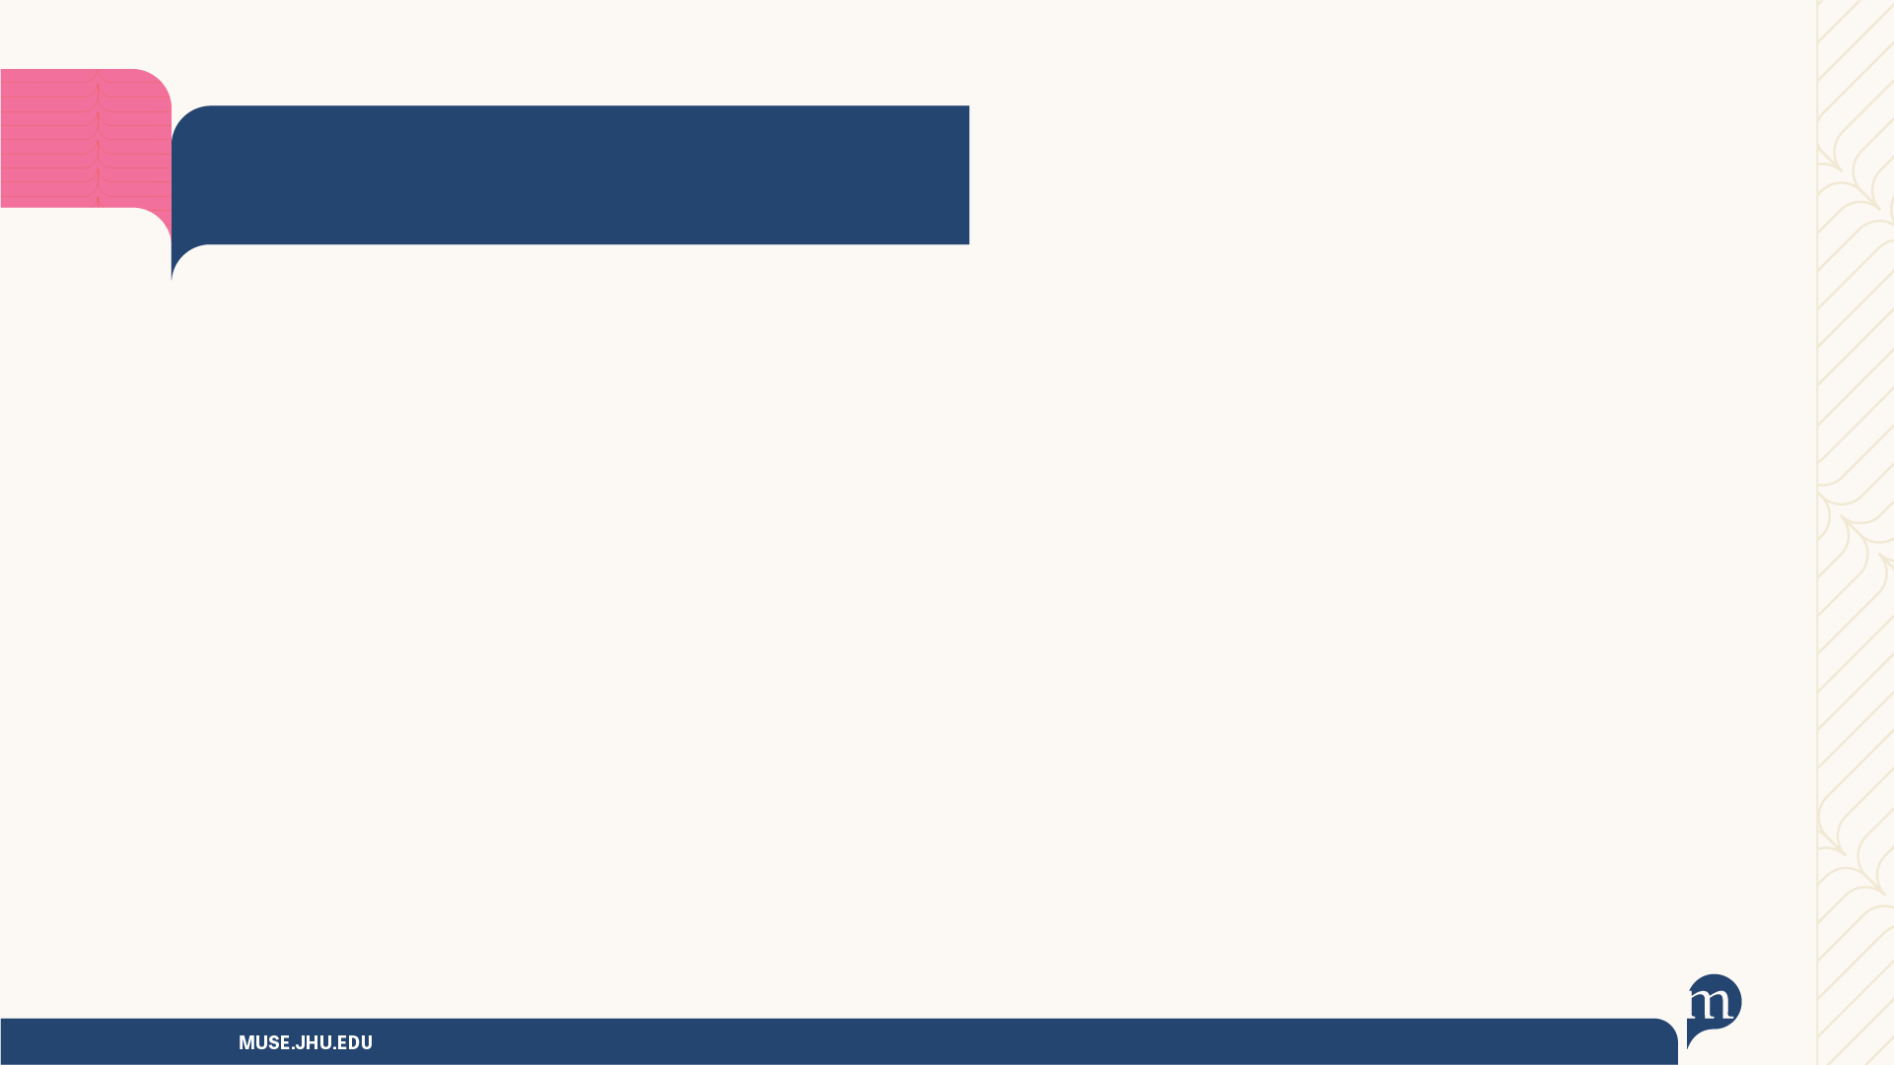

How does S2O work?
S2O makes open access for participating journals’ current content contingent on library subscribers’ ongoing support.
The MUSE S2O offer…
ensures subscribing libraries continue uninterrupted access to both current scholarship and archival backfile content
requires no new investment from libraries – just continued support for a trusted, vital scholarly resource
allows all authors to publish open access without cost to them
has potential to open a wealth of scholarship in disciplines often underserved by other OA models
Notes:
So, how exactly does S2O work? Subscribe to Open allows subscription journals to open up access to their current content without APCs. As the names suggests, S2O makes open access contingent upon library subscribers’ ongoing support. Our S2O program will ensure that subscribers to the MUSE journal collections will have uninterrupted access to both current scholarship and our wealth of archival backfile content for hundreds of journals in MUSE. It requires no new investment from libraries, just their continued support for a trusted and valuable resource. Through that support from MUSE’s community of thousands of libraries worldwide, the S2O offer will open a wealth of vital scholarship in disciplines not well served by other OA models.

Slide 5
What will not change
Much won’t change about MUSE Journal Collection subscriptions with S2O
MUSE’s suite of interdisciplinary and broadly discipline-specific collections
Our approach to collection pricing
Channels for renewing or placing new orders (consortia, agents, direct)
Our business policies and commitments to our customers
License terms for gated content
Notes:
Many of the questions about S2O that have been raised by our current subscribers and partners have to do with things they really like about our journal collections, so I wanted to take a few minutes to reassure you about all the things that WON’T change with the introduction of an S2O program at MUSE.
We will continue to offer the same set of familiar collections to which libraries currently subscribe. Building our S2O offer around these flagship collections means that libraries can support journals transitioning to open simply by renewing their subscriptions to these trusted, essential resources. The titles included in the collections will not change – the titles from each collection that participate in the S2O offer will simply make their new content OA if the offer is successful.
Our approach to collection pricing will not change. MUSE has always moderated annual price increases. Modest increases are necessary to cover development and maintenance of our platform to meet current industry standards, the addition of carefully curated new content to the collections, and increases in our operating costs. As a division of a non-profit university press, Project MUSE invests any surplus back into improving our platform, sustaining our participating publishers, and supporting the ecosystem of academy-owned scholarly communications.
Libraries will be able to renew their subscriptions or place new orders via the same channels. MUSE’s relationships with library consortia, sales partners, and subscription agents worldwide have been crucial to our ability to reach and serve a large and diverse customer base. Libraries may continue to subscribe via the channel of their choice.
Our business policies and commitments to our customers will not change. Subscriptions will still run on a calendar year basis, and we will still offer collection trial access for potential new subscribers. COUNTER-compliant statistics will be provided, and we will continue to distribute robust metadata to all major library discovery partners. Ensuring the accessibility of all content on the platform will remain imperative, and we’ll continue to partner with Portico on archiving all content.
And finally, license terms for gated content will not change. Our current, library-friendly license terms will continue to apply to all gated content in the journal collections, and we will not require libraries or consortia to sign new licenses. If the sustainability threshold is not reached and the S2O offer fails, all content will remain gated and nothing will change. If the S2O offer succeeds, new content from participating journal titles, published during the calendar year subscription term, will be open access upon publication. All older volumes and issues will remain gated and the existing license terms will apply.

Slide 6
How will libraries participate?
Simply put – renew your subscription as usual
Subscribers continue to have guaranteed access to current journal content, and to backfile content, for all journals in their selected collection, even if the sustainability threshold is not reached and content from S2O titles is not opened
Cancelling your subscription means losing access to all the gated content via the MUSE platform, including the non-S2O journals and backfile content
If the offer succeeds, the S2O-participating journals will make all their current-year content open access
Notes:
So what does a library subscribing to one or more MUSE journal collections need to do to participate in our S2O offer? Simply put – just continue to renew your subscription as usual. Beginning in 2025, when we launch the S2O offer, those subscriptions will support a portion of the titles in the collection in making all their current-year content open access.
Subscribing libraries will continue to have guaranteed access to the current journal content, and to the journals’ backfile content, for all journals in their selected collection, even if the sustainability threshold is not reached and the content from the S2O titles is not opened.
A library that cancels its subscription, however, would lose access to all the gated content on the MUSE platform, including the non-S2O journals and all backfile content.
If the S2O offer succeeds, the participating journals will make all their current-year content open access upon publication, under a Creative Commons license. Any content opened by S2O remains open in perpetuity.

Slide 7
What determines success?
The annual sustainability threshold must be met for S2O to succeed
Calendar year revenue target – the funding necessary to continue to maintain Project MUSE and its participating publishers
Sustainability threshold – the percentage of the target that must be met by the participation deadline in order for the participating journals to make their current content OA
If the sustainability threshold is not reached within the offer timeframe, all the content remains gated and available only to subscribers
Notes:
You’ve heard me mention the offer “succeeding or failing” a couple times now, and you may wonder how we would determine it’s success. There are two important components to making this decision. The first is a calendar year revenue target, which is an amount that we would determine annually as the funding necessary to continue to maintain both Project MUSE’s operations, and those of our participating publishers, many of whom rely significantly on the royalties they receive from MUSE to sustain their publishing activities. We will also determine a sustainability threshold, which is the percentage of that revenue target we must achieve by the participation deadline in order for the offer to succeed, and the participating journals to make their content open access. If the sustainability threshold is not reached, all content remains gated and available only to subscribers. We expect that sustainability threshold to be quite high, because as a not-for-profit, we already operate on slim margins and do not have large reserves to fall back upon should support not reach the levels we anticipate. We also have a long history of very robust renewal rates and stable continuous support from our library subscribers, and believe that an ambitious sustainability threshold is both realistic, and crucial, for an S2O offer at this scale to be viable over time.

Slide 8
What happens after 2025?
Project MUSE’s S2O offer will recur annually with each subscription term
Content for each new calendar year subscription term is opened one year at a time – conditional on meeting the annual sustainability threshold
Any content opened by S2O remains perpetually OA, licensed under a Creative Commons license
Additional journals may choose to participate once the offer has established success
Notes:
Things don’t end with 2025, of course. The Subscribe to Open offer will then recur annually, with a new calendar year of content from participating journal titles becoming open access so long as the annual sustainability threshold is met. As mentioned earlier, content opened by S2O will be perpetually open, under a Creative Commons license determined by the publisher. MUSE will be meticulous in the creation and dissemination of our metadata, for both the OA content and remaining gated content, to help libraries maintain good records and to ensure the most robust discovery of the open content, particularly by users in the wider community outside of subscribing institutions. Once we have established success with the model, we anticipate that more journals in our collections will chose to participate, and make more essential scholarship open to all.

Slide 9
Find out more
Participating Publishers (and their journals)
Subscribe to Open (S2O) at Project MUSE
Download MUSE S2O Brochure (PDF)
Notes:
Things don’t end with 2025, of course. The Subscribe to Open offer will then recur annually, with a new calendar year of content from participating journal titles becoming open access so long as the annual sustainability threshold is met. As mentioned earlier, content opened by S2O will be perpetually open, under a Creative Commons license determined by the publisher. MUSE will be meticulous in the creation and dissemination of our metadata, for both the OA content and remaining gated content, to help libraries maintain good records and to ensure the most robust discovery of the open content, particularly by users in the wider community outside of subscribing institutions. Once we have established success with the model, we anticipate that more journals in our collections will chose to participate, and make more essential scholarship open to all.

Slide 10
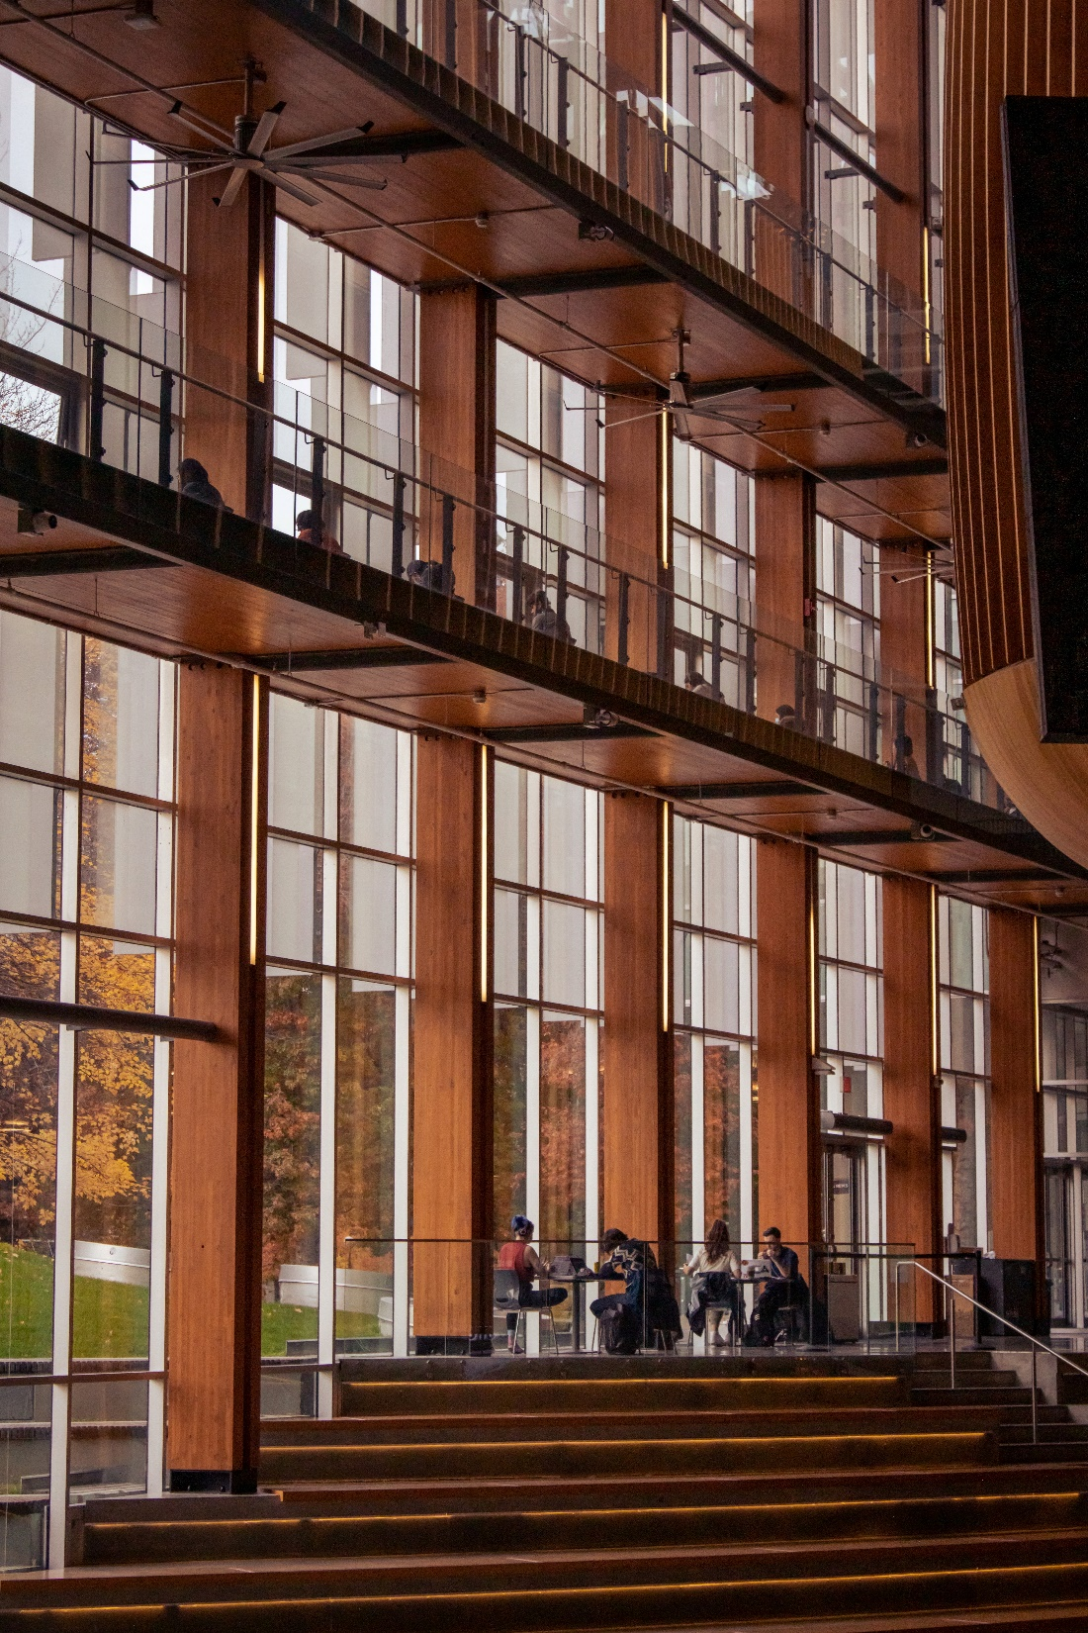
MUSE has Open Access Books!
~5,000 fully open access books from nearly 100 publishers
Same high editorial standards as for all content on the platform
Free MARC records, discovery integration, search integration
Notes:
Before I close today, I feel like I would be remiss if I did not also mention that MUSE has a lot of open access books! Some 5000 of them, in fact, from nearly 100 publishers, including many of the same university presses and scholarly societies from whom we also have journals and books for sale. We encourage libraries to download our free MARC records and turn on our Open Access Books collection in your discovery layers to help readers and researchers find their way to this wealth of freely-available scholarship.

Slide 11

2024 PLUS+ Journals Package

Slide 12
What is PLUS+?
The Project MUSE Journals PLUS+ Package provides access to a large bundle of titles that are part of our journal hosting program. These titles are not included in any of the curated MUSE Journal Collections.
The PLUS+ Package is offered at a 5% discount from the sum of the individual annual subscription fees for the included titles. Further discounts may be available by ordering via one of MUSE's consortium partners.
All journals in the MUSE journal hosting program are peer-reviewed, from not-for-profit scholarly publishers, and cover a wide range of humanities and social science disciplines.
The 2024 PLUS+ Package includes 77 journal titles from 38 publishers. Download the title list for the 2024 PLUS+ Package

Slide 13

Some Titles!
CrossCurrents
Decisions of the Roman Rota
Demokratizatsiya: The Journal of Post-Soviet Democratization
Early Middle English
Environment, Space, Place
Ériu
Fairy Tale Review
Feminist Studies
Filipino American National Historical Society Journal
German Yearbook of Contemporary History
Group
Health and History
Hesperia: The Journal of the American School of Classical Studies at Athens
Historical Performance
Home Front Studies
MUSE.JHU.EDU
#PROJECTMUSE

Slide 14
Latin American University Press Books

Slide 15
Latin American UP Books
Elevating the global visibility of this important Spanish-language scholarship from Latin American presses is a key component of MUSE’s commitment to equity, inclusion, and diversity.
MUSE has made agreements with more than 80 Latin American presses to contribute books to the initiative.
MUSE has partnered with EULAC, the Association of University Presses of Latin America and the Caribbean.
Projected to include Portuguese-language scholarship from Brazil.
There are nearly 1,000 titles available now with about 5,000 anticipated to be on the platform by the end of 2024, if not more.
Download a list of participating publishers (.xls).

Slide 16


For More Information
Subscribe to Open (S2O)
PLUS+ Journals Package
Latin American Books
MUSE.JHU.EDU
#PROJECTMUSE

Slide 17

Thank You!
Doug Storm
Dstorm.muse@jhu.edu

